Slide 1
FACE LOGIN SYSTEM
Made By: Amogh Garg

Slide 2
PROBLEM STATEMENT
Develop a browser-based application or a native mobile application to demonstrate the application of Face Recognition technology. You could choose to demonstrate application of Face Recognition in any area of application of your choice.
Face-Recognition

Slide 3
About the Project
The most general way to authenticate users while using web-based or even mobile-based applications is by using username and alphanumeric password. But for many users this process becomes a bit cumbersome because remembering different usernames and passwords for different websites is not an easy task. Therefore the idea of simplifying the login process on different websites by eliminating the need to remember different usernames and passwords drives the project.
But you might be thinking how this could be done? A very efficient way to authenticate users is by using their biometrics like fingerprints, face-recognition, retina-scan etc.
So, my project is concerned with building a face login system which can be easily integrated with different web-applications for login aspects.
Once the users signup on the application, for login purposes they would not be required to remember their username and password as the system will automatically identify all the user-credentials just by recognizing their face.

Slide 4
Technology used
Frontend
Backend
HTML
CSS
Bootstrap
JavaScript
Python:
Flask
Keras-Facenet Model (Face-Recognition Model)
MongoDB

Slide 5
FUNCTIONAL FEATURES
Signup: The user can create an account by using his/her email-id. The password is stored in the database in encrypted form.
Login: The user can login to his/her account directly just by allowing the website to take his/her photo.
Logout: Users can end the session by clicking on logout button.
All the images of the users are not stored in the database, only encodings generated from image are stored in binary-file.
NOTE: Only the most recent photograph of the most recent user is stored in the project’s working directory for the purpose of uploading it to the server. Apart from this no image is stored.
FAQ: Why is there a need to enter password during signup if authentication will be based on face-recognition? Ans. Entering password can be made optional in future in case a user doesn’t want to use face login system and continue with classical approach of authentication. (THIS FEATURE HAS NOT BEEN IMPLEMENTED AND FOR NOW ENTERING PASSWORD IS MANDATORY)
Following are the functional features which I have implemented in this project

Slide 6
FACENET MODEL
Overview
FaceNet is a Deep Neural Network used for face verification, recognition and clustering. It directly learns mappings from face images to a compact Euclidean plane. When an input image of 96X96 RGB is given it simply outputs a 128-dimensional vector which is the embedding of the image.
This model is a Face2Vec type of model. Face2Vec refers to the conversion of the image into vector (encodings).
Strengths:
Able to identify similar faces through different facial expressions and angles.
Able to identify the same faces despite having markings on the face.
Weakness:
If individuals are wearing eyewear, Face2Vec overfocused on similar eyewear.

Slide 7
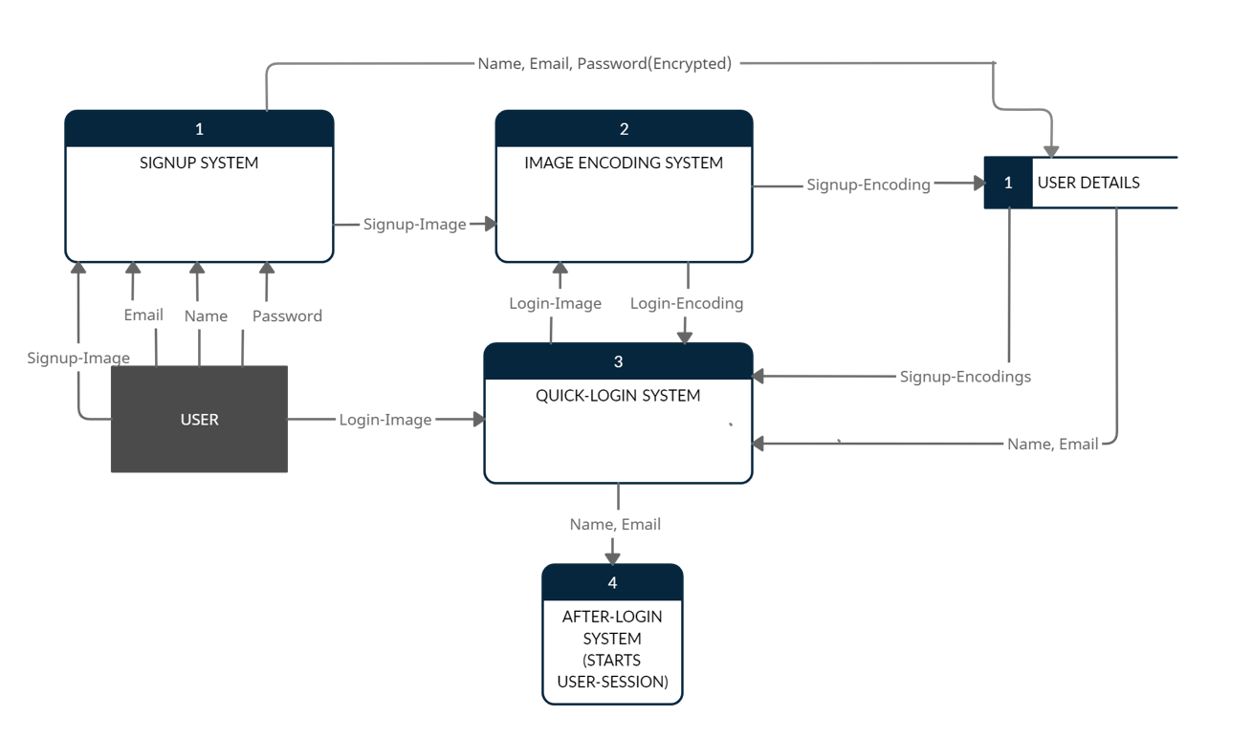
DATA FLOW DIAGRAM

Slide 8
WORK FLOW OF THE SYSTEM
User signs-up on the website by entering their name, email, password and then website takes a photograph of user’s face.
The image of the face is converted into encoding (referred to as signup-encoding) and the encoding is stored in a binary-file which is saved in the same directory as that of project’s source-code. The name, email, password (in encrypted form) and name of the binary-file (containing the encoding) is stored in the MongoDB database. NOTE: This binary-file is different for every user.
The account has now been created and the user can now login.
To login, the users just have to allow the website to take a photograph of their face. This photograph is converted into the encoding (referred to as login-encoding in DFD).
Quick Login-System now fetches the name of all the binary-files from the database and compares the present login-encoding with the signup-encoding stored in the binary-file. If the difference in value is less than 0.7 we say that the two encodings are nearly equal and the access is authorized.
Users can end the session by clicking on logout button.

Slide 9
Improvements for the future
The accuracy of the face-recognition model should be improved in terms of recognizing the same person with/without beard, moustache, spectacles etc.
The model should also be able to acknowledge the change a user’s face has undergone as a result of ageing.
Time-complexity of the algorithm concerned with matching the login-encoding with all the signup-encodings can be improved by sorting users based on places (like Delhi, Mumbai etc.).
Few iterations and improvements can be made to this system to make it perfect for real-world application.

Slide 10
THANK YOU!

